Slide 1

GFT
Data Analytics Practice
2015

Slide 2
About Me
Angel Rey
Software engineer. Big Data developer / Architect
Utad master
Working at GFT, and before at ZED and Bongiorno/Lumata as Big data Devolper / Architect
Before Spark default big data tools were MongoDB, Hadoop Ecosystem, Elastic Search

Slide 3
Content
What is Apache Spark
Core Spark Concepts
The Spark shell
RDDs
Pair RDDs
Persistence
Data partitioning
Loading and saving data
Shared variables
Working on per-partition basis
Numeric RDD Operation
Spark architecture
Spark configuration
Spark SQL
DataFrames
Spark Streaming
MLib

Slide 4
Exercise 0: Prepare Environment

Slide 5
What is Apache Spark
Apache Spark is a cluster computing platform designed to be fast and generalpurpose.
On the speed side, Spark extends the popular MapReduce model to efficiently support more types of computations, including interactive queries and stream processing.
On the generality side, Spark is designed to cover a wide range of workloads that previously required separate distributed systems, including batch applications, iterative algorithms, interactive queries, and streaming
Spark is designed to be highly accessible, offering simple APIs in Python, Java, Scala, R and SQL
Spark can run in Hadoop clusters and access any Hadoop datasource

Slide 6
Introducing Spark
Apache Spark is an open-source cluster computing framework
Requires Cluster manager
Standalone – a simple cluster manager included with Spark
Apache Mesos – a general cluster manager
Hadoop YARN – the resource manager in Hadoop 2
Distributed storage system
Hadoop Distributed File System (HDFS)
Cassandra
OpenStack Swift
Amazon S3
Tachyon
Also supports pseudo-distributed mode for development and testing
local file system
one worker per CPU core

Slide 7
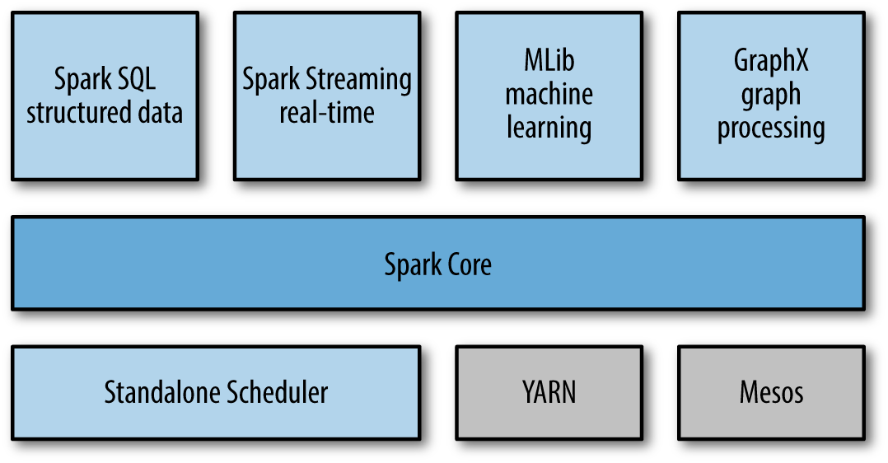
Unified stack
Core
scheduling, distributing, and monitoring applications consisting of many computational tasks across many worker machines
Higher-level components specialized for various workloads
SQL: It allows querying data via SQL as well as the Apache Hive variant of SQL and DataFrames
Machine learning: MLlib provides multiple types of machine learning algorithms, including classification, regression, clustering, and collaborative filtering
Graph processing: To perform graph-parallel computations
Stream processing: That enables processing of live streams of data like server logfiles

Slide 8

Brief History
2009 - Initially started at UC Berkeley AMPLab
https://amplab.cs.berkeley.edu/
2010 - Open sourced under a BSD license
2013 - Donated to the Apache Software Foundation
Apache 2.0 license
Feb 2014 - Became an Apache Top-Level Project
Nov 2014 - Databricks set a new world record in large scale sorting using Spark
100TB (1 trillion records) sorted in 23 minutes, 206 EC2 machines
Previously: Hadoop MapReduce, 72 minutes, 2100 machines
3X faster, 10X fewer machines
Sorting on HDFS (disk), not using in-memory cache!

Slide 9
Problems with Traditional Large-Scale Systems
MapReduce
Is batch oriented
So, Hive, Pig and all MR-based systems too
Great throughput but high latency
Not for BI tools
Not for real-time (stream) processing
Programming model not good for iterative programming (e.g. machine learning)
Forces to concatenate multiple jobs
External orchestration
Each job flushes to disk
Data sharing requires external storage

Slide 10
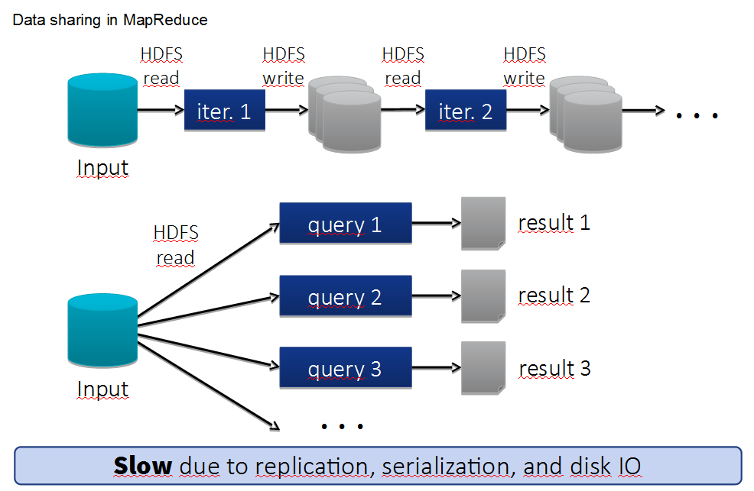
Problems with Traditional Large-Scale Systems

Slide 11
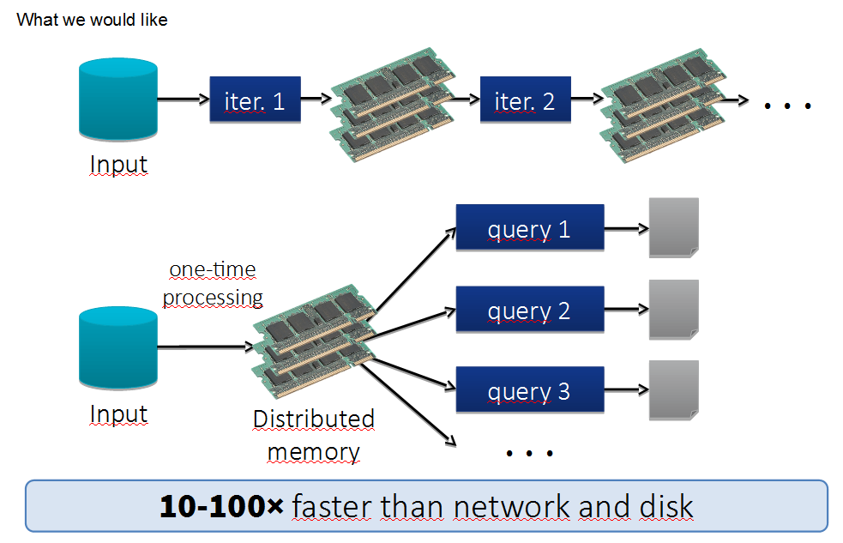
Problems with Traditional Large-Scale Systems

Slide 12
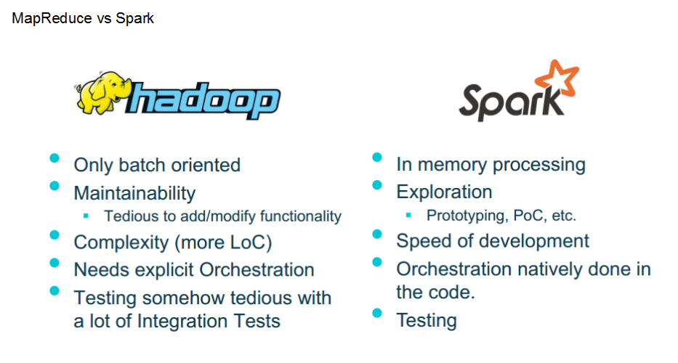
Problems with Traditional Large-Scale Systems

Slide 13
Exercise 1: Wordcount MapReduce

Slide 14
Core Spark Concepts
Every Spark application consists of a driver program that defines distributed datasets on a cluster and then launches various parallel operations to them.
Driver can be your own program or the Spark shell (see later) to type operations you want to run.
Driver access Spark through a SparkContext object wich represents a connection to a cluster (in the shell is automatically created and called sc)

Slide 15
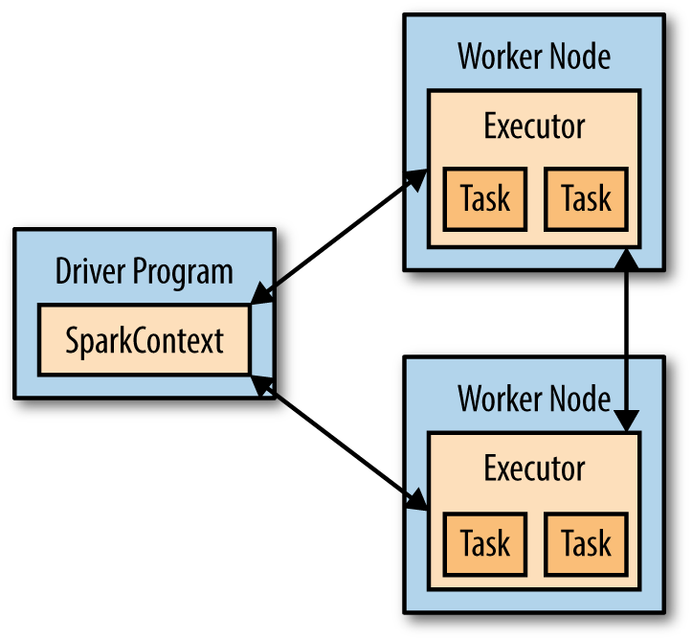
Core Spark Concepts (cont.)
In Spark, we express our computation through operations on distributed collections that are automatically parallelized across the cluster. These collections are called resilient distributed datasets, or RDDs
To run these operations, driver programs typically manage a number of nodes called executors.
Basic components for distributed execution in Spark:

Slide 16
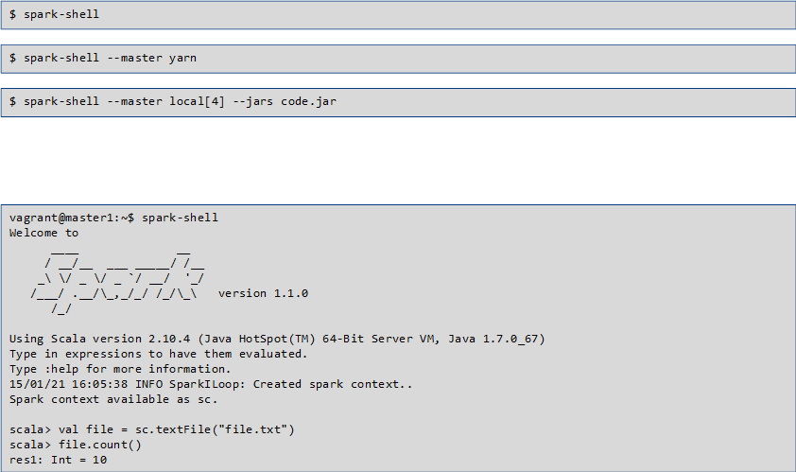
Using the Spark Shell

Slide 17
Spark operations example
scala> val lines = sc.textFile("README.md") // Create an RDD called lines
lines: spark.RDD[String] = MappedRDD[...]
scala> lines.count() // Count the number of items in this RDD
res0: Long = 127
scala> lines.first() // First item in this RDD, i.e. first line of README.md
res1: String = # Apache Spark
scala> val pythonLines = lines.filter(line => line.contains("Python"))
pythonLines: spark.RDD[String] = FilteredRDD[...]
scala> pythonLines.first()
res0: String = ## Interactive Python Shell

Slide 18
Building your own application
If we are building our own driver (not using the shell) we have to define to setup the spark context
import org.apache.spark.SparkConf;
import org.apache.spark.api.java.JavaSparkContext;
SparkConf conf = new SparkConf().setMaster("local").setAppName("My App");
JavaSparkContext sc = new JavaSparkContext(conf);
// …
sc.stop()
And for compiling add Spark core dependencies in the build.sbt project file
// additional libraries
libraryDependencies ++= Seq(
"org.apache.spark" %% "spark-core" % "1.5.0" % "provided"
)
A cluster URL, namely local in this example, which tells Spark how to connect to a cluster. local is a special value that runs Spark on one thread on the local machine, without connecting to a cluster.
An application name, namely My App in this example. This will identify your application on the cluster manager’s UI if you connect to a cluster

Slide 19
Exercise 2: Using Spark Shell

Slide 20
RDD Basics
An RDD in Spark is simply an immutable distributed collection of objects. Each RDD is split into multiple partitions, which may be computed on different nodes of the cluster. RDDs can contain any type of Python, Java, R or Scala objects, including userdefined classes.
Users create RDDs in two ways: by loading an external dataset (like before) or by distributing a collection of objects (e.g., a list or set) in their driver program.
scala> val lines = sc.textFile("README.md")
Once created, RDDs offer two types of operations:
Transformations construct a new RDD from a previous one. For example, one common transformation is filtering data that matches a predicate.
val pythonLines = lines.filter(line => line.contains("Python"))
Actions compute a result based on an RDD, and either return it to the driver program or save it to an external storage system (e.g., HDFS).
scala> lines.first()

Slide 21
RDD Basics (cont.)
Sparks computes RDDs in a Lazy way. It sees the whole chain of transformations and compute just the data needed for its result the first time they are used in an action.
Spark’s RDDs are by default recomputed each time you run an action on them.
If you would like to reuse an RDD in multiple actions, you can ask Spark to persist it using RDD.persist().
Example:
scala> pythonLines.persist
scala> pythonLines.count()
2
scala> pythonLines.first()
u'## Interactive Python Shell'

Slide 22

Creating RDDs
Using parallelize (). Useful for learning, prototyping and testing
val lines = sc.parallelize(List("pandas", "i like pandas"))
Load data from external storage
val lines = sc.textFile("/path/to/README.md")

Slide 23
Transformations
Lazy operations, returning new RDD
val inputRDD = sc.textFile("log.txt")
val errorsRDD = inputRDD.filter(line => line.contains("error"))
val warningsRDD = inputRDD.filter(line => line.contains("warning"))
val badLinesRDD = errorsRDD.union(warningsRDD)
operation does not mutate the existing inputRDD.
Returns a pointer to an entirely new RDD.
inputRDD is reused later for warnings
Spark keeps track of the set of dependencies between different RDDs, called the lineage graph.
It uses this information to compute each RDD on demand and to recover lost data if part of a persistent RDD is lost.

Slide 24
Actions
operations that return a final value to the driver program or write data to an external storage system.
Force the evaluation of the transformations required for the RDD
Example: counting errors
println("Input had " + badLinesRDD.count() + " concerning lines")
println("Here are 10 examples:")
badLinesRDD.take(10).foreach(println)
RDDs also have a collect() function to retrieve the entire RDD. This can be useful if your program filters RDDs down to a very small size and you’d like todeal with it locally. Keep in mind that your entire dataset must fit in memory on asingle machine to use collect()
we used take() to retrieve a small number of elements in the RDD
at the driver program. We then iterate over them locally to print out information at
the driver.

Slide 25
Passing Functions to Spark
Most of Spark’s transformations, and some of its actions, depend on passing in functions that are used by Spark to compute data
We can pass in functions defined inline, references to methods, or static functions as we do for Scala’s other functional APIs
The function we pass and the data referenced in it needs to be serializable (@serializable)
Passing a method or field of an object includes a reference to that whole object (Spark sends the entire object to worker nodes) we extract the fields we need as local variables and avoid needing to pass the whole object
class SearchFunctions(val query: String) {
def isMatch(s: String): Boolean = {
s.contains(query)
}
def getMatchesFunctionReference(rdd: RDD[String]): RDD[Boolean] = {
// Problem: "isMatch" means "this.isMatch", so we pass all of "this"
rdd.map(isMatch)
}
def getMatchesFieldReference(rdd: RDD[String]): RDD[Array[String]] = {
// Problem: "query" means "this.query", so we pass all of "this"
rdd.map(x => x.split(query))
}
def getMatchesNoReference(rdd: RDD[String]): RDD[Array[String]] = {
// Safe: extract just the field we need into a local variable
val query_ = this.query
rdd.map(x => x.split(query_))
}
}

Slide 26
Common Transformations And Actions
Map & Filter
val input = sc.parallelize(List(1, 2, 3, 4))
val result = input.map(x => x * x)
println(result.collect().mkString(","))
Flatmap
val lines = sc.parallelize(List("hello world", "hi"))
val words = lines.flatMap(line => line.split(" "))
words.first() // returns "hello"

Slide 27
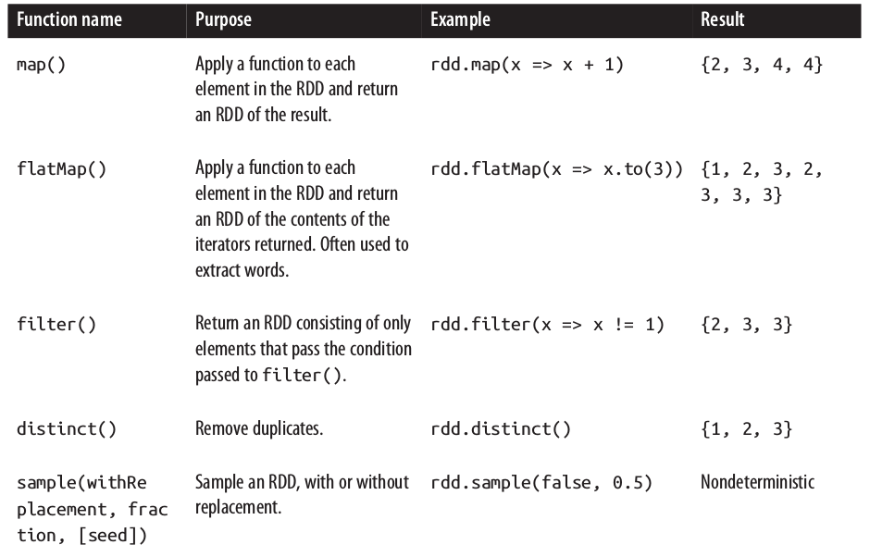
RDD Operations
Basic RDD transformations on an RDD containing {1, 2, 3, 3}

Slide 28
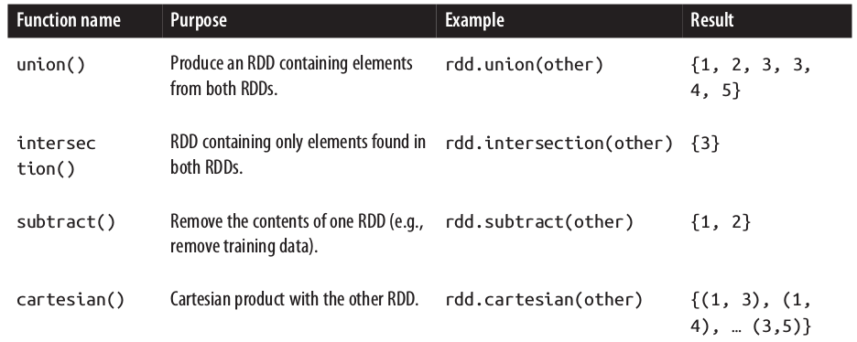
RDD Operations
Two-RDD transformations on RDDs containing {1, 2, 3} and {3, 4, 5}

Slide 29
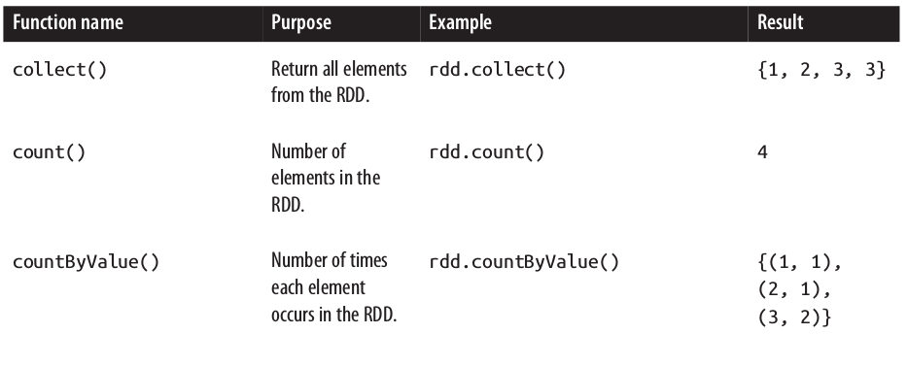
RDD Operations
Basic actions on an RDD containing {1, 2, 3, 3}

Slide 30
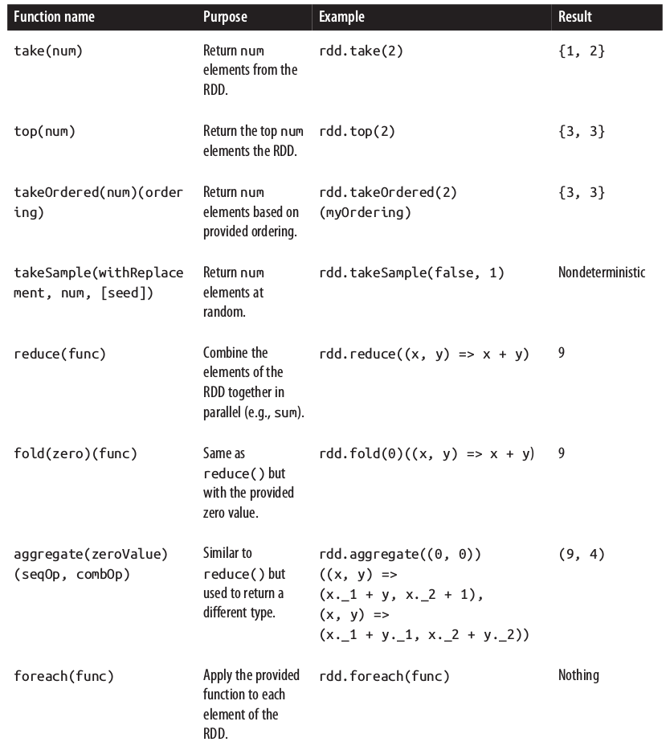
RDD Operations
More actions on an RDD containing {1, 2, 3, 3}

Slide 31
Key/Value Pairs RDDs
Spark provides special operations on RDDs containing (key, value) pairs
they expose operations that allow you to act on each key in parallel, regroup or agregate data across the network.
Creating pair RDD:
Many formats loading return pair RDDs for key/value data.
Parallelize (for testing and pocs)
val pairs = sc.parallelize (List((1,”a”),(2,”b”),(3,”c”)))
Running transformations over regular RDDs
//pair RDD using the first word as the key
val pairs = lines.map(x => (x.split(" ")(0), x))

Slide 32
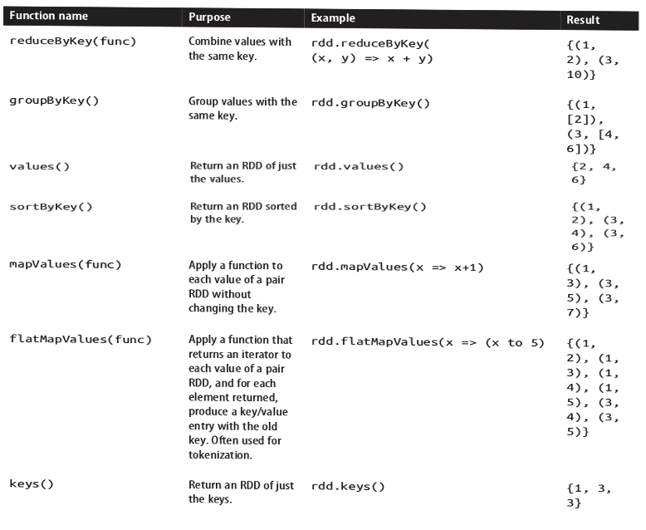
Pair RDD Operations
Transformations on one pair RDD (example: {(1, 2), (3, 4), (3, 6)})

Slide 33
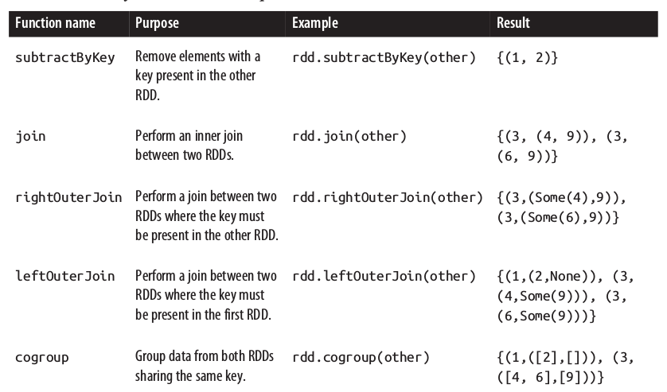
Pair RDD Operations
transformations on two pair RDDs (rdd = {(1, 2), (3, 4), (3, 6)} other = {(3, 9)})

Slide 34
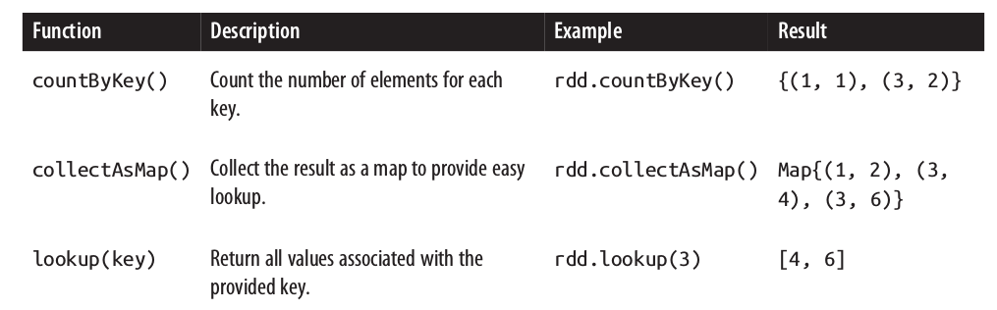
Pair RDD Operations
Actions on pair RDDs (example ({(1, 2), (3, 4), (3, 6)}))

Slide 35
Exercise 3: WordCount Spark
Exercise 4: Top-10 WordCount
Exercise 5: Combine RDDs

Slide 36
Persistence (caching)
Remember: Spark recomputes the RDD each time an action is called
val result = input.map(x => x*x)
// result.persist (StorageLevel.LEVEL)
println(result.count())
println(result.collect().mkString(","))
To avoid this we can persit the data, especially with iterative algorthims.
Each node stores their partitions of the RDD
the default persist() will store the data in the JVM heap (memory) as unserialized objects
If a node that has data persisted on it fails, Spark will recompute the lost partitions of the data when needed.
If you attempt to cache too much data to fit in memory, Spark will automatically evict old partitions using a Least Recently Used (LRU) cache policy.
RDDs come with a method called unpersist() that lets you manually remove them from the cache

Slide 37
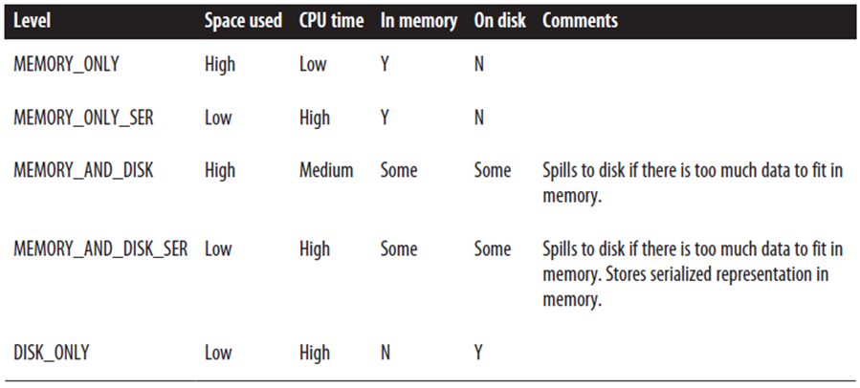
Persistence
Persistence levels:
cache() = persist(StorageLevel.MEMORY_ONLY)
Which storage level to choose?
Use MEMORY_ONLY if possible → there is memory enough
If not, use MEMORY_ONLY_SER a
Spill to disk Just if
the functions that computed your RDDs are expensive
or they filter a large amount of the data
Otherwise, recomputing a partition is faster than reading from disk

Slide 38
Exercise 6: Data Mining with MovieLens Dataset

Slide 39
Data Partitioning
partitioning is available on all RDDs of key/value pairs, and causes the system to group elements based on a function of each key.
Although Spark does not give explicit control of which worker node each key goes to.
it lets the program ensure that a set of keys will appear together on some node.
For example, you might choose to hash-partition an RDD into 100 partitions so that keys that have the same hash value modulo 100 appear on the same node

Slide 40
Data Partitioning
Example (works but not efficient)
// Initialization code; we load the user info from a Hadoop SequenceFile on HDFS.
// This distributes elements of userData by the HDFS block where they are found,
// and doesn't provide Spark with any way of knowing in which partition a
// particular UserID is located.
val sc = new SparkContext(...)
val userData = sc.sequenceFile[UserID, UserInfo]("hdfs://...").persist()
// Function called periodically to process a logfile of events in the past 5 minutes;
// we assume that this is a SequenceFile containing (UserID, LinkInfo) pairs.
def processNewLogs(logFileName: String) {
val events = sc.sequenceFile[UserID, LinkInfo](logFileName)
val joined = userData.join(events)// RDD of (UserID, (UserInfo, LinkInfo)) pairs
val offTopicVisits = joined.filter {
case (userId, (userInfo, linkInfo)) => // Expand the tuple into its components
!userInfo.topics.contains(linkInfo.topic)
}.count()
println("Number of visits to non-subscribed topics: " + offTopicVisits)
}

Slide 41
Data Partitioning
Why is not efficent?
The join() operation called each time processNewLogs() is invoked, does not know anything about how the keys are partitioned in the datasets
Because we expect the userData table to be much larger than the small log of events seen every five minutes, this wastes a lot of work:
the userData table is hashed and shuffled across the network on every call, even though it doesn’t change.

Slide 42
Data Partitioning
Solution:
Use org.apache.spark.HashPartitioner with transformation partitionBy():
val sc = new SparkContext(...)
val userData = sc.sequenceFile[UserID, UserInfo]("hdfs://...")
.partitionBy(new HashPartitioner(100)) // Create 100 partitions
.persist()
The processNewLogs() method remains unchanged: the events RDD is local to processNewLogs(), and is used only once within this method, so there is no advantage in specifying a partitioner for events.
Because we called partitionBy() when building userData, Spark will now know that it is hash-partitioned, and calls to join() on it will take advantage of this information. when we call user Data.join(events), Spark will shuffle only the events RDD, sending events with each particular UserID to the machine that contains the corresponding hash partition of userData
it is important to persist userData. If not subsequent uses of the RDD will result in complete lineage revaluation, repeated partitioning and shuffling data across the network
The number of partitions control how many parallel tasks will be performed on the RDD (e.g. joins) → at least as large of the number of cores in the cluster
It’s possible use others (RangePartitioner) or implement our own partitioner from org.apache.spark.Partitioner

Slide 43
Data Partitioning
Determine partitioner of an RDD
scala> val pairs = sc.parallelize(List((1, 1), (2, 2), (3, 3)))
pairs: spark.RDD[(Int, Int)] = ParallelCollectionRDD[0] at parallelize at <console>:12
scala> pairs.partitioner
res0: Option[spark.Partitioner] = None
scala> import org.apache.spark.HashPartitioner
import org.apache.spark.HashPartitioner
scala> val partitioned = pairs.partitionBy(new HashPartitioner(2)).persist()
partitioned: spark.RDD[(Int, Int)] = ShuffledRDD[1] at partitionBy at <console>:14
scala> partitioned.partitioner
res1: Option[spark.Partitioner] = Some(spark.HashPartitioner@5147788d)
Operations That Benefit from Partitioning
1RDD: All the values for each key to be computed locally on a single machine, requiring only the final, locally reduced value to be sent from each worker node back to the master
groupByKey(), reduceByKey(), lookup()
2RDD: At least one of the RDDs will not be shuffled. If both have the same partitioner and cached on the same server (eg. One was created from other using mapValues) then no shuffling will occur.
cogroup(), join(), leftOuterJoin(), rightOuterJoin()
Operations That Affect Partitioning
if you call map() on a hash-partitioned RDD of key/value pairs, the function passed to map() can in theory change the key of each element, so the result will not have a partitioner
So operations that result in a partitioner being set on the output RDD:
cogroup(), join(), leftOuterJoin(), rightOuterJoin(), groupByKey(), reduceByKey(), partitionBy(), sort()
if the parent RDD has a partitioner: mapValues(), flatMapValues(),filter()

Slide 44
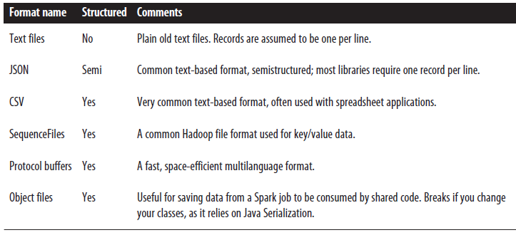
Loading and saving Data
Spark can access data used by Hadoop (S3, HDFS, Cassandra Hbase, etc…) and local filesystem
Common supported file formats

Slide 45
Loading and saving Data
Text Files
val input = sc.textFile("file:///home/holden/repos/spark/README.md")
Multiples Files (in pair RDD, key name of file)
Support directories & wildcards
Average value per file
val input = sc.wholeTextFiles("file:///home/holden/salesFiles")
val result = input.mapValues{y =>
val nums = y.split(" ").map(x => x.toDouble)
nums.sum / nums.size.toDouble
}
Loading CSV with textFile() in Scala and opencsv Library
No newline inside a field
import java.io.StringReader
import au.com.bytecode.opencsv.CSVReader
...
val input = sc.textFile(inputFile)
val result = input.map{ line =>
val reader = new CSVReader(new StringReader(line));
reader.readNext();
}
New lines inside a field
case class Person(name: String, favoriteAnimal: String)
val input = sc.wholeTextFiles(inputFile)
val result = input.flatMap{ case (_, txt) =>
val reader = new CSVReader(new StringReader(txt));
reader.readAll().map(x => Person(x(0), x(1)))
}

Slide 46
Loading and saving data
Saving RDD as a text file
result.saveAsTextFile(outputFile)
CVS: Write a function that converts the fields to given positions in an comma separated line and save as text file.

Slide 47
Loading and saving Data
Sequence Files
Flat files with key/value pairs
With sync markers that allow Spark read SequenceFiles in parallel from multiples nodes
Consists of elements that implement Hadoop’s Writable Interface Like IntWritable, Text …
Add dependencies of hadoop to your sbt project
Always map the loading to Scala types for doing computation (many Hadoop Writables do not implement java.io.Serializable )
val data = sc.sequenceFile(inFile, classOf[Text], classOf[IntWritable]).
map{case (x, y) => (x.toString, y.get())}
Or use sequenceFile[Key, Value](path) that returns native Scala types
Saving sequenceFile
val data = sc.parallelize(List(("Panda", 3), ("Kay", 6), ("Snail", 2)))
data.saveAsSequenceFile(outputFile)

Slide 48
Loading and saving data
Spark also can interact with Hadoop input and output formats
Example loading with new KeyValueTextInputFormat for reading key/value data from text files
val input = sc.newAPIHadoopFile[Text, Text, KeyValueTextInputFormat](inputFile).map{
case (x, y) => (x.toString, y.toString)
}
Example saving with a sequence file output format
result.saveAsNewAPIHadoopFile(fileName, Text.class, IntWritable.class, SequenceFileOutputFormat.class);

Slide 49
Loading and saving data
Filesystems
Local filesystem:
requires that the files are available at the same path on all nodes in your cluster. If not load locally on the driver and then parallelize
val rdd = sc.textFile(“file:///home/holden/happypandas.txt”)
Amazon S3:
Set AWS_ACCESS_KEY_ID and AWS_SECRET_ACCESS_KEY environment variables in each worker
Fast if nodes are in EC2
val rdd = sc.textFile(“s3n://bucket/pathwithin-bucket”)
HDFS
Take advantage of this data locality to avoid network overhead
val rdd = sc.textFile(“hdfs://master:port/path”)

Slide 50
Loading and saving data
Spark SQL ready for working with structured data in a relational way has its own context (see later)
Can load Hive tables (SQL like abstraction over Hadoop map-reduce)
Copy hive-site.xml to Spark conf directory
And use HiveContext wich is a specialization of SQLContext
import org.apache.spark.sql.hive.HiveContext
val hiveCtx = new HiveContext(sc)
val rows = hiveCtx.sql("SELECT name, age FROM users")
val firstRow = rows.first()
println(firstRow.getString(0)) // Field 0 is the name

Slide 51
Loading and saving data
Loading data from a database
def createConnection() = {
Class.forName("com.mysql.jdbc.Driver").newInstance();
DriverManager.getConnection("jdbc:mysql://localhost/test?user=holden");
}
def extractValues(r: ResultSet) = {
(r.getInt(1), r.getString(2))
}
val data = new JdbcRDD(sc,
createConnection, "SELECT * FROM panda WHERE ? <= id AND id <= ?",
lowerBound = 1, upperBound = 3, numPartitions = 2, mapRow = extractValues)
println(data.collect().toList)
Saving data to a database (using Hadoop DBOutputFormat)
val records = data.map(e => (catRecord(e._1, e._2), null))
val tableName = "table"
val fields = Array("name", "age")
val jobConf = new JobConf()
DBConfiguration.configureDB(jobConf, "com.mysql.jdbc.Driver", "jdbc:mysql://localhost/test?user=holden")
DBOutputFormat.setOutput(jobConf, tableName, fields:_*)
records.saveAsHadoopDataset(jobConf)
[…]
case class catRecord(name: String, age: Int) extends DBWritable {
override def write(s: PreparedStatement) {
s.setString(1, name)
s.setInt(2, age)
}
override def readFields(r: ResultSet) = {
// blank since only used for writing
}
}

Slide 52
Shared Variables
Functions (map, filter,…) can use variables defined outside them in the driver program
But each task running on the cluster gets a new copy of each variable
Updates from thes copies not return to driver
Accumulators & Broadcast variables relax this restriction for Agregation and broadcasts

Slide 53
Shared variables
Acumulators
Agregation values from workers to driver
For example count some kind of events during job execution
Accumulator empty line count in Scala:
val file = sc.textFile("file.txt")
val blankLines = sc.accumulator(0) // Create an Accumulator[Int] initialized to 0
val callSigns = file.flatMap(line => {
if (line == "") {
blankLines += 1 // Add to the accumulator
}
line.split(" ")
})
callSigns.saveAsTextFile("output.txt")
println("Blank lines: " + blankLines.value)
we will see the right count only after we run the saveAsTextFile() action, because the transformation above it, map(), is lazy
accumulators are write-only variables. This allows accumulators to be implemented efficiently

Slide 54
Shared variables
Accumulators and Fault tolerance
Same function may run mutiple times on the same data:
If a operation crashes or a node is slow and a “speculative” copy of the task is launched on other node or for rebuilding a cached value that falls out of memory
for accumulators used in actions, Spark applies each task’s update to each accumulator only once (can be used actions like foreach() and is OK)
But for accumulators used in RDD transformations instead of actions, this guarantee does not exist (use only for debugging)

Slide 55
Shared Variables
Broadcast variables, allows the program to efficiently send a large, read-only value to all the worker nodes for use in one or more Spark operations
Like send a large, read-only lookup table to all the nodes
Sparks send all variables in your clousures to the worker nodes but can be inefficent:
The default task launching mechanism is optimized for small task sizes
You might, in fact, use the same variable in multiple parallel operations, but Spark will send it separately for each operation
Broadcast variable are read-only
Example
val signPrefixes = sc.broadcast(loadCallSignTable())
val countryContactCounts = contactCounts.map{case (sign, count) =>
val country = lookupInArray(sign, signPrefixes.value)
(country, count)
}.reduceByKey((x, y) => x + y)
countryContactCounts.saveAsTextFile(outputDir + "/countries.txt")

Slide 56
Exercise 7: Average WordLength

Slide 57
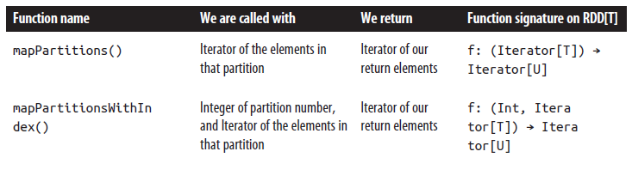
Working on a Per-Partition Basis
Allow us to avoid redoing setup work for each data item (like opening a database conector)
Spark has per-partition versions of map and foreach to help reduce the cost of these operations by letting you run code only once for each partition of an RDD.

Slide 58
Working on a Per-Partition Basis
Example
import org.apache.spark._
import org.eclipse.jetty.client.ContentExchange
import org.eclipse.jetty.client.HttpClient
object BasicMapPartitions {
def main(args: Array[String]) {
val master = args.length match {
case x: Int if x > 0 => args(0)
case _ => "local"
}
val sc = new SparkContext(master, "BasicMapPartitions", System.getenv("SPARK_HOME"))
val input = sc.parallelize(List("KK6JKQ", "Ve3UoW", "kk6jlk", "W6BB"))
val result = input.mapPartitions{
signs =>
val client = new HttpClient()
client.start()
signs.map {sign =>
val exchange = new ContentExchange(true);
exchange.setURL(s"http://qrzcq.com/call/${sign}")
client.send(exchange)
exchange
}.map{ exchange =>
exchange.waitForDone();
exchange.getResponseContent()
}
}
println(result.collect().mkString(","))
}
}

Slide 59
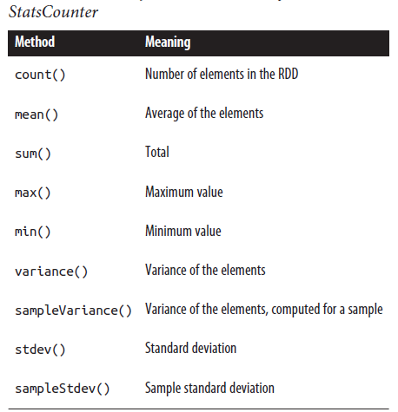
Numeric RDD Operations
Spark provides several descriptive statistics operations on RDDs containing numeric data
The descriptive statistics are all computed in a single pass over the data and returned as a StatsCounter object by calling stats().
// remove outliers since those may have misreported locations
// first we need to take our RDD of strings and turn it into doubles.
val distanceDouble = distance.map(string => string.toDouble)
val stats = distanceDoubles.stats()
val stddev = stats.stdev
val mean = stats.mean
val reasonableDistances = distanceDoubles.filter(x => math.abs(x-mean) < 3 * stddev)
println(reasonableDistance.collect().toList)

Slide 60
Spark Runtime architecture
Master/slave architecture
Central coodinator driver (own java process)
Daemons on workers called executor (own java process)
Dirver + executors = Spark application
Application is launched using a cluster manager

Slide 61
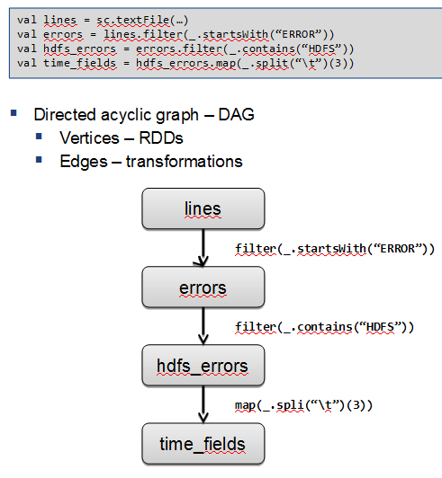
The Driver
Is the process where the main() method of your program runs
It is the process running the user code that creates a SparkContext, creates RDDs, and performs transformations and actions
Performs two duties
Converting a user program into tasks:
Creates a logical directed acyclic graph (DAG) of operations.
Converts DAG into a physical execution plan
Creates a series of stages based on DAG optimizing transformations and merging them
Each stage consists of multiple tasks (smallest unit of work). They are bundled up and sent to the cluster
Scheduling tasks on executors
Uses physical execution plan
At start executors register themselves to the driver. Each executor can run task and store RDD slices
Based on data placement the driver schedule each task to a worker
Driver tracks the location of cached data

Slide 62

Executors
Java processes responsible for running individual tasks in a Spar job
Two roles
Run the tasks and return results to the driver
Provide in-memory storage for RDDs through a service called Block Manager

Slide 63
Components of Execution
Phases of execution with an example:compute how many log messages appear at each level of severity
## input.txt ##
INFO This is a message with content
INFO This is some other content
(empty line)
INFO Here are more messages
WARN This is a warning
(empty line)
ERROR Something bad happened
WARN More details on the bad thing
INFO back to normal messages
For that we type this sequence of commands
// Read input file
scala> val input = sc.textFile("input.txt")
// Split into words and remove empty lines
scala> val tokenized = input.
| filter(line => line.size > 0).
| map(line => line.split(" ")).
// Extract the first word from each line (the log level) and do a count
scala> val counts = tokenized.
| map(words => (words(0), 1)).
| reduceByKey{ (a, b) => a + b }

Slide 64
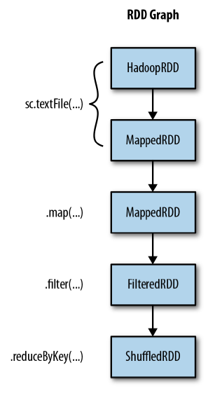
Components of Execution
Due there are no actions only DAG was created. To display the lineage of the RDDs we can use toDebugString
scala> input.toDebugString
res85: String =
(2) input.text MappedRDD[292] at textFile at <console>:13
| input.text HadoopRDD[291] at textFile at <console>:13
scala> counts.toDebugString
res84: String =
(2) ShuffledRDD[296] at reduceByKey at <console>:17
+-(2) MappedRDD[295] at map at <console>:17
| FilteredRDD[294] at filter at <console>:15
| MappedRDD[293] at map at <console>:15
| input.text MappedRDD[292] at textFile at <console>:13
| input.text HadoopRDD[291] at textFile at <console>:13

Slide 65
Components of Execution
When we perform the action Spark’s scheduler creates a physical execution plan to compute the RDDs
scala> counts.collect()
res86: Array[(String, Int)] = Array((ERROR,1), (INFO,4), (WARN,2))
scheduler performs pipelining, or collapsing of multiple RDDs into a single stage.
Pipelining occurs when RDDs can be computed from their parents without data movement
Each stage has tasks for each partition in that RDD
Spark’s internal scheduler may truncate the lineage of the RDD graph if an existing RDD has already been persisted

Slide 66
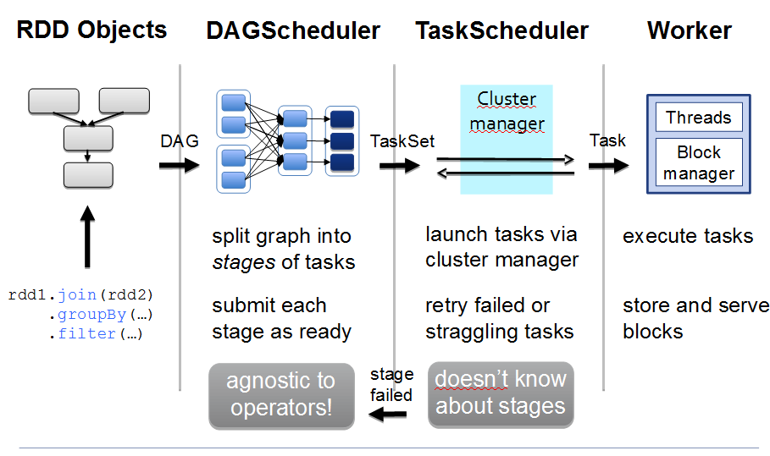
Driver / executor steps

Slide 67
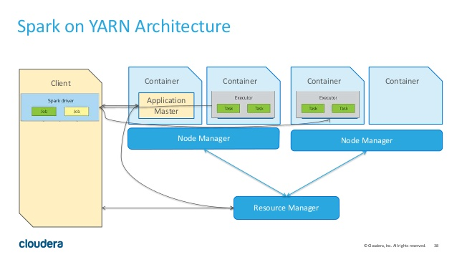
Cluster Manager
The cluster manager is a pluggable component. Can run on top of YARN, Mesos and a Stand-alone cluster manager

Slide 68
Launching a program
Single script spark-submit with options to conect to clusters and control resources
The user submits an application using spark-submit.
spark-submit launches the driver program and invokes the main() method specified by the user.
The driver program contacts the cluster manager to ask for resources to launch executors.
The cluster manager launches executors on behalf of the driver program.
The driver process runs through the user application. Based on the RDD actions and transformations in the program, the driver sends work to executors in the form of tasks.
Tasks are run on executor processes to compute and save results.
If the driver’s main() method exits or it calls SparkContext.stop(), it will terminate the executors and release resources from the cluster manager.

Slide 69
Spark Configuration
Primary mechanism: SparkConf
val conf = new SparkConf()
conf.set("spark.app.name", "My Spark App")
conf.set("spark.master", "local[4]")
conf.set("spark.ui.port", "36000") // Override the default port
// Create a SparkContext with this configuration
val sc = new SparkContext(conf)
SparkConf provides methods por setting comon params like setAppName() and setMaster ()
spark-submit provides flags for most common config and –conf to setup any config value
$ bin/spark-submit \
--class com.example.MyApp \
--master local[4] \
--name "My Spark App" \
--conf spark.ui.port=36000 \
myApp.jar
Spark-submit reads conf/spark-default.conf file but you can customize the location:
$ bin/spark-submit \
--class com.example.MyApp \
--properties-file my-config.conf \
myApp.jar
## Contents of my-config.conf ##
spark.master local[4]
spark.app.name "My Spark App"
spark.ui.port 36000
Full List of configuration are in the Spark documentation http://spark.apache.org/docs/latest/configuration.html

Slide 70
Spark web UI
Available at http://<server-driver>:4040
YARN: http://<ResourceManager>:4040
Jobs: Progress and metrics of stages, tasks, and more
Storage: Information for RDDs that are persisted
Executors: A list of executors present in the application
Environment: Debugging Spark’s configuration

Slide 71
Drivers and Executor logs
In Yarn
yarn logs -applicationId <app ID> when app has finished (logs are agregated)
For running app: click through the ResourceManager UI to the Nodes page, then browse to a particular node, and from there, a particular container

Slide 72
Tuning
Level of Parallelism
If too litle→ resources idles
If too much →overhead for each partition can be a problem
To tune
In operations that shuffle data you can give a degree of parallelism via parameter
A RDD can be distribute to have more or fewer partitions
repartition () shuffle a RDD into desired number of partitions
If shrinking use coalesce() (avoids shuffle)
# Wildcard input that may match thousands of files
>>> input = sc.textFile("s3n://log-files/2014/*.log")
>>> input.getNumPartitions()
35154
# A filter that excludes almost all data
>>> lines = input.filter(lambda line: line.startswith("2014-10-17"))
>>> lines.getNumPartitions()
35154
# We coalesce the lines RDD before caching
>>> lines = lines.coalesce(5).cache()
>>> lines.getNumPartitions()
5
# Subsequent analysis can operate on the coalesced RDD...
>>> lines.count()

Slide 73
Serialization
Use Kyro (faster than default java serialization)
val conf = new SparkConf()
conf.set("spark.serializer", "org.apache.spark.serializer.KryoSerializer")
// Be strict about class registration
conf.set("spark.kryo.registrationRequired", "true")
conf.registerKryoClasses(Array(classOf[MyClass], classOf[MyOtherClass]))

Slide 74
Spark SQL
Interfaz for working with structured (schema) and semistructured data
Three main capabilities:
DataFrame abstraction for structured datasets. Similar to tables in Relational database.
Read & write in structured formats (JSON, Hive, Parquet)
Query data using SQL inside Spark program & from external tools using JDBC/ODBC

Slide 75
DataFrame
Extension of the RDD model
A DataFrame contains
RDD of Row objects, each representing a record
Schema (i.e., data fields) of its rows
Data is stored in a more efficient manner than RDDs (due the schema)
Provide new operations and can run SQL queris
Creation from:
External data sources
Result of queries
Regular RDDs

Slide 76
Linking with Spark SQL
Add dependencies:
If you want Hive support (hive tables, UDFS, SerDes & HiveQL) (Recommended) Does not requiere an Hive installation
libraryDependencies += "org.apache.spark" % "spark-hive_2.10" % "1.5.0
If only want SQL
libraryDependencies += "org.apache.spark" % "spark-sql_2.11" % "1.5.0“
Entry points
SQLContext: extends standard context
HiveContext:extends SQLContext (recommended due HiveQL is used as standard query language in Spark)
If you have a Hive installation copy hive-site.xml to Spark conf directory.
If not Spark SQL will create its own Hive metastore in your program’s working directory metastore_db and tables will be placed in /user/hive/ware-house in local filesystem or HDFS if you have hdfs-site.xml on your classpath

Slide 77
Using SparkSQL in Applications
Easy Data load and query combining with “regular” code
Import Contexts
// Import Spark SQL
import org.apache.spark.sql.hive.HiveContext
// Or if you can't have the hive dependencies
//import org.apache.spark.sql.SQLContext
Create a SQL context
val sc = new SparkContext(...)
val hiveCtx = new HiveContext(sc)
Import implicits to convert RDDs into specialized RDDs for querying
val hiveCtx = ...
// Import the implicit conversions
import hiveCtx.implicits._
Basic Query
Load some twitter data from JSON and register as “temporay table” for SQL query
val input = hiveCtx.jsonFile(inputFile)
// Register the input schema RDD
input.registerTempTable("tweets")
// Select tweets based on the retweetCount
val topTweets = hiveCtx.sql("SELECT text, retweetCount FROM
tweets ORDER BY retweetCount LIMIT 10")

Slide 78
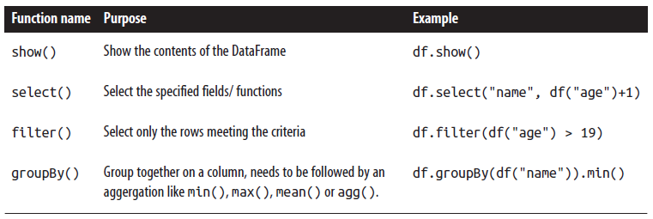
Using SparkSQL in Applications
DataFrames provide an access to the RDD: .rdd() so you can user RDD transformatios like map() or filter. Example access first columm:
val topTweetText = topTweets.rdd().map(row => row.getString(0))
With registerTempTable() method, Hive context can query the dataFrame (as in example)
Tables created are local to HiveContext used and go away when app ends
Basic DataFrame operations
Name, Age {Row(“Bear”,None), Row(“Databricks”, 1)}

Slide 79
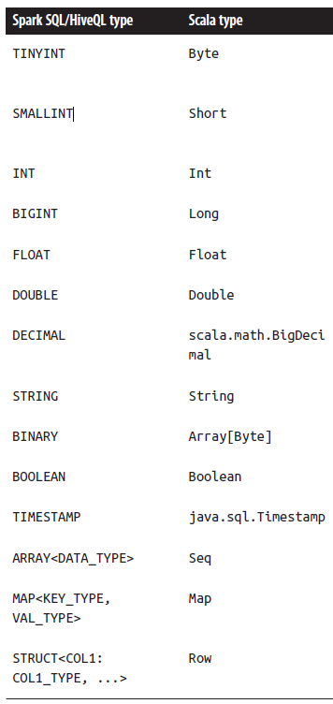
Types stored by DataFrames
The last type, structures, is simply represented as other Rows in Spark SQL.
All ofthese types can also be nested within each other
For example, you can have arrays of structs, or maps that contain structs.

Slide 80
Caching in Spark SQL
Caching in Spark SQL works different:
For using the memory efficient representation use
hiveCtx.cacheTable("tableName")
You can also cache using HiveSQL statments
CACHE TABLE tableName or UNCACHE TABLE tableName.
When caching a table Spark SQL represents the data in an in-memory columnar format.
The cached table will remain in memory only for the life of our driver program.

Slide 81
Loading and Saving Data
In adition to Hive, JSON and Parquet, Spark SQL has a DataSource Api for integration
Some notable implementations include Avro, Hbase, ES, Cassandra…
Its possible convert a regular RDDs to DataFrames by assigning them a schema

Slide 82
Loading and Saving Data
Apache Hive (seen before):
import org.apache.spark.sql.hive.HiveContext
val hiveCtx = new HiveContext(sc)
val rows = hiveCtx.sql("SELECT key, value FROM mytable")
val keys = rows.map(row => row.getInt(0))
Parquet, column-oriented storage formats can store records with nested fields efficiently
// Load some data in from a Parquet file with field's name and favouriteAnimal
rows = hiveCtx.load(parquetFile, "parquet")
names = rows.map(row => row.name)
println ("Everyone“)
names.collect().foreach (println)
// Find the panda lovers
tbl = rows.registerTempTable("people")
pandaFriends = hiveCtx.sql("SELECT name FROM people WHERE favouriteAnimal = ‘panda’")
println ("Panda friends“)
pandaFriends.map(row => row.name).collect().foreach (println)
pandaFriends.save("hdfs://...", "parquet")
Avro a data serialization system which relies on schemas
Include in sbt project: libraryDependenicies += "com.databricks" %% "spark-avro" % "2.0.1"
Replace “parquet” by “com.databricks.spark.avro” in previous example

Slide 83
Loading and Saving Data
JSON: Spark SQL can infer the schema by scanning the file and let you access fields by name
{"name": "Holden"}
{"name":"Sparky The Bear", "lovesPandas":true, "knows":{"friends": ["holden"]}}
val input = hiveCtx.jsonFile(inputFile)
input.printShema()
root
|-- knows: struct (nullable = true)
| |-- friends: array (nullable = true)
| | |-- element: string (containsNull = false)
|-- lovesPandas: boolean (nullable = true)
|-- name: string (nullable = true)
Access in SQL
select knows.friends(0) from table_input limit 1;

Slide 84
Loading and Saving Data
From RDDs: Any RDD with case classes is implicitly converted into a DataFrame
case class HappyPerson(handle: String, favouriteBeverage: String)
// Create a person and turn it into a Schema RDD
val happyPeopleRDD = sc.parallelize(List(HappyPerson("holden", "coffee")))
// Note: there is an implicit conversion
// that is equivalent to
// sqlCtx.createDataFrame(happyPeopleRDD)
happyPeopleRDD.registerTempTable("happy_people")
Also you can use .toDF
val df = sc.parallelize(List(HappyPerson("holden", "coffee"))).toDF

Slide 85
JDBC /ODBC Server
Useful for connection BI tools to Spark Cluster
JDBC server runs a standalone Spark driver that can be shared with multiple clients
JDBC server corresponds to HiveServer2 in Hive (is a Thrift server) listen in port:10000
./sbin/start-thriftserver.sh --master sparkMaster
Server can share cached tables betwee multiples programs (is a single driver program)

Slide 86
Working with Beeline
Beeline: SQL shell client can connect to server via JDBC
spark$ ./bin/beeline –u jdbc:hive2://localhost:10000
0: jdbc:hive2://localhost:10000> show tables;
+---------+
| result |
+---------+
| pokes |
+---------+
1 row selected (1.182 seconds)
You can use standard HiveQL
> CREATE TABLE IF NOT EXISTS mytable (key INT, value STRING)
ROW FORMAT DELIMITED FIELDS TERMINATED BY ',';
> LOAD DATA LOCAL INPATH 'int_string.csv'
INTO TABLE mytable;
> SHOW TABLES;
Mytable
To See query plan
spark-sql> EXPLAIN SELECT * FROM mytable where key = 1;
== Physical Plan ==
Filter (key#16 = 1)
HiveTableScan [key#16,value#17], (MetastoreRelation default, mytable, None), None
Spark SQL also support a simple shell for local development
./bin/spark-sql

Slide 87
Spark SQL UDFs
UDFs allow register custom functions to call within SQL
Spark SQL offers an easy method to register UDFs
hiveCtx.udf.register("strLenScala", (_: String).length)
val tweetLength = hiveCtx.sql("SELECT strLenScala('tweet') FROM tweets LIMIT 10")
Using existing Hive UDFS
Standard Hive UDFs are already included
The jars of your UDFs have to be included in the project. If using JDBC server add - -jar command-line flag
To make UDFs available
hiveCtx.sql("CREATE TEMPORARY FUNCTION name AS class.function")

Slide 88
Exercise 8: Data Mining Using SparkSQL
Exercise 9: Running spark jobs inside IntelliJ IDE
Exercise 10: Dataframes
Exercise 11: Dataframes
Exercise 12: Spark RDD testing
Exercise 13: Spark DataFrame testing exercise

Slide 89
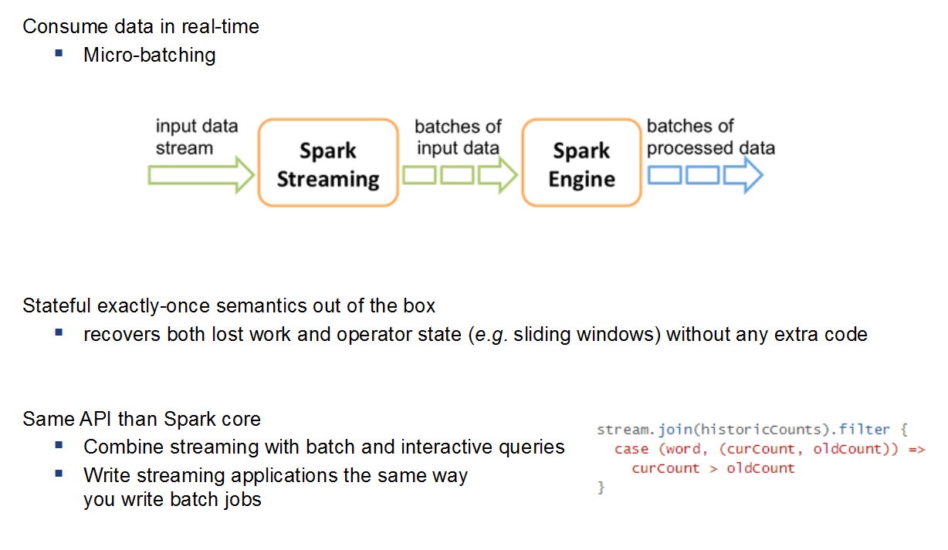
Spark Streaming

Slide 90
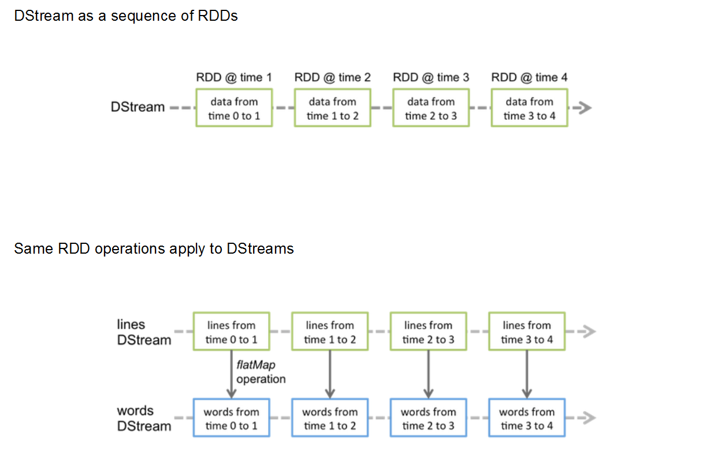
Spark Streaming

Slide 91
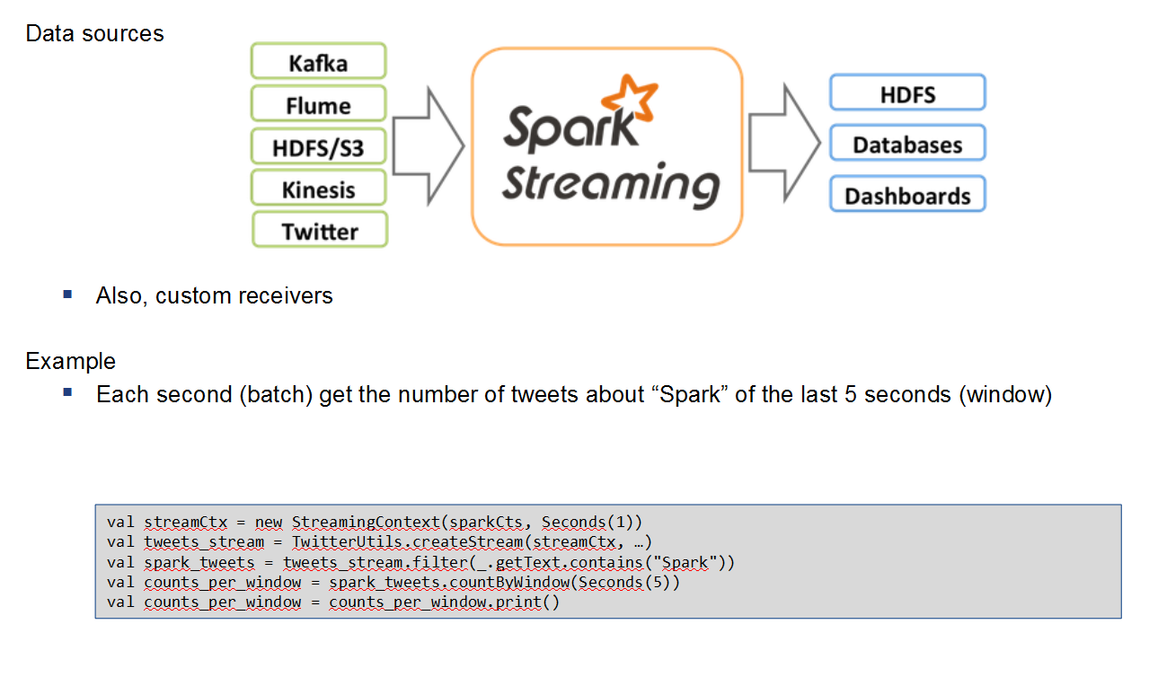
Spark Streaming

Slide 92
MLib
Algorithms
Classification (discrete) and regression (continue)
e.g: credit scoring, marketing campaigns, …
Linear models: SVMs, logistic regression, linear regression
Naive Bayes
Decision trees
Collaborative filtering
e.g: recommenders
Alternating least squares – ALS
Clustering
e.g: social network analysis (communities)
K-Means

Slide 93
Exercise 14: Recommender Algorithms
Exercise 15: Deploy program in a Spark Cluster

Slide 94
The end
Contact me alje@gft.com
Linkedin https://es.linkedin.com/in/chicochica10

